Slide 1

Does every app have the chance to succeed in Google Play?
Tomer Dvir
Avi Chickvashvili

Slide 2

Before choosing this topic, it was important for us to choose a topic that is relevant to our daily lives. Recently, we have developed an app which may be uploaded to Google Play in the near future.
We thought to ourselves, what is the chance of our app actually succeeding?
Using the tools we acquired during the course, we will present the conclusions.

Slide 3
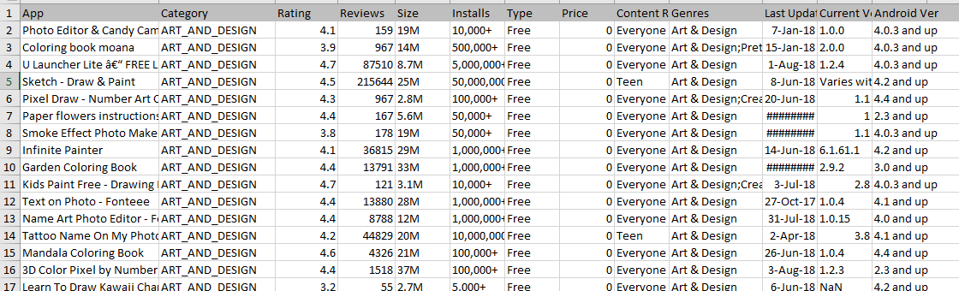
The classification was performed as follows: Our classification above the 4.4 rating will be defined as successful - otherwise, unsuccessful. In addition, there are other parameters for which the machine performs the learning - Category, Rating, Size, Installs.

Slide 4
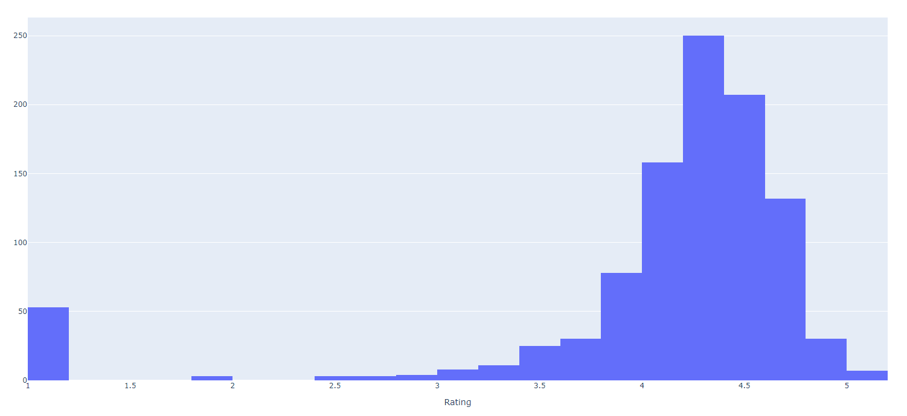
Before we defined what a successful application is, we summarized in the table a segmentation of the rating of the applications in the dataset.
As can be seen from the table, most of the applications are above rating 4 - and not all of them are necessarily successful.
Therefore, we decided that a successful application - above rating 4.4.

Slide 5
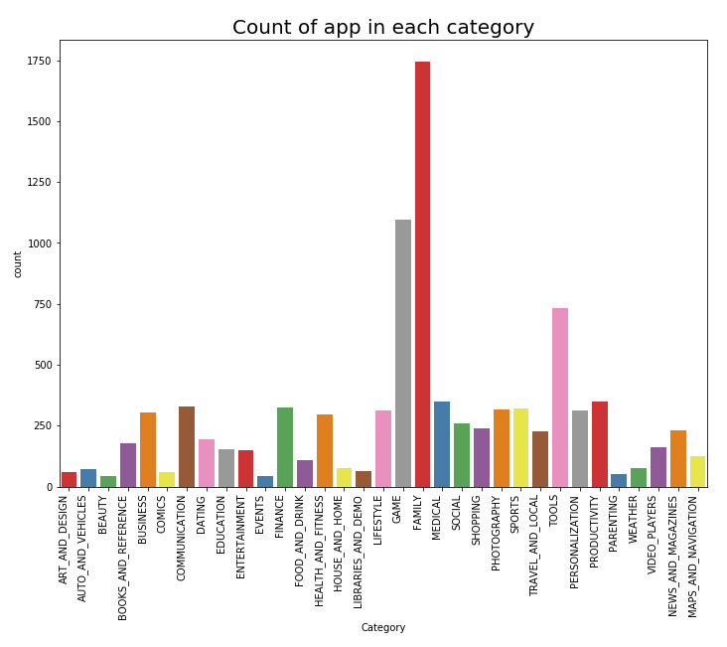
At the beginning of the data analysis, we checked the number of applications from each category:
Game and Family category are the most appearances for application in store.

Slide 6
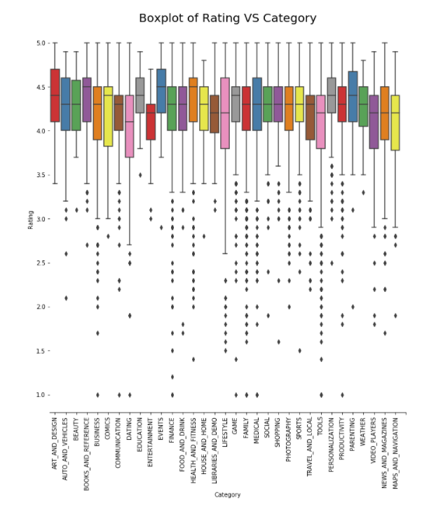
As you can see, rating of application in each category is not different too much

Slide 7
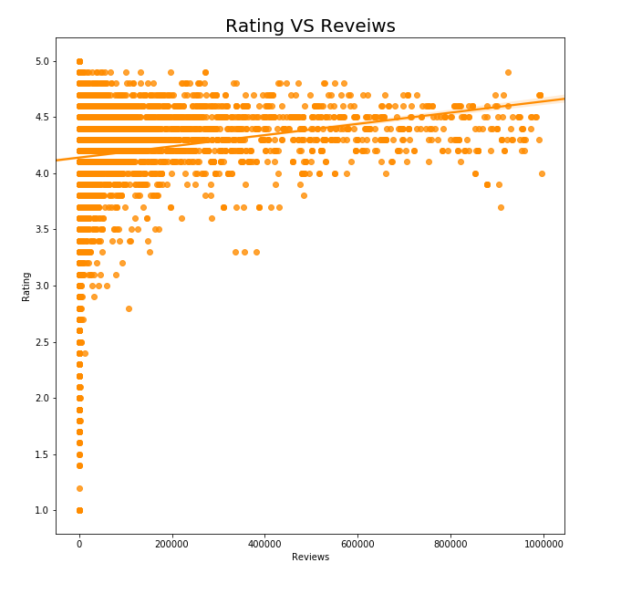
Application that well-known probably will get a good rating

Slide 8
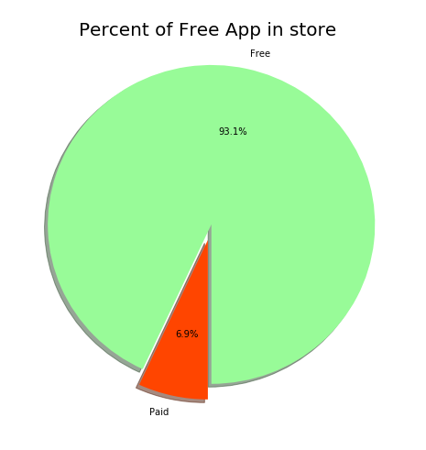
Most of application in this store are free (93.1%).

Slide 9

The six algorithms we chose to use in the data set analysis:
Decision Tree
Logistic Regression
ADABOOST
SVM
KNN
NAÏVE BAYSE

Slide 10
Decision Tree result:
0.67
SVM result:
0.604
ADABOOST result:
0.602
Logistic Regression result:
0.604

Slide 11
Analysis:
The algorithms with the best result: Decision Tree - 67%
The algorithms with the worst result: ADABOOST - 60.02%
notes:
Data processing was performed on a dataset before use:
The categories have been replaced by numbers
Sources:
https://www.kaggle.com/lava18/google-play-store-apps
https://towardsdatascience.com/predicting-wine-quality-with-several-classification-techniques-179038ea6434
Changes made since last meeting:
Add information analysis for additional parameters.
Adding additional algorithms

